Slide 1

DriverPass System Analysis
Destinee Herrera

Slide 2

System Requirements
Functional Requirements
Students can choose to schedule driving lesson packages online.
Students can take practice test.
Nonfunctional Requirements
The system must be cloud based and accessible from multiple devices
The system must use secure login and protect user data
Notes:
DriverPass will have some important requirements that focus on customer centered functionality and secure access. The main functional requirements will be that students will be able to schedule lessons with instructors and take practice exams that would simulate the actual DMV test.
The main nonfunctional requirements are that the system will use a cloud-based server and ensure the security of sensitive user information.

Slide 3
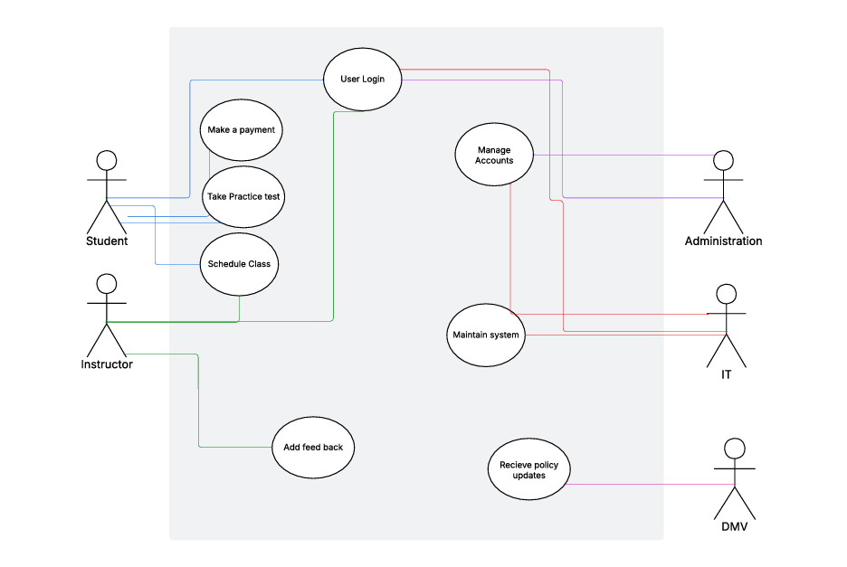
Use Case Diagram
Notes:
This diagram shows the different people who use the DriverPass system. Of course, we have students and instructors, but I also included administration, IT, and the DMV.
Students will be able to log in, schedule a class, take a practice test, and make a payment. Instructors can schedule lessons and leave feedback for students.
On the staff side, administration manages accounts, and IT helps keep the system running smoothly. I also included the DMV because it is important that the system stays up to date with current policies and procedures to remain compliant with the law.

Slide 4
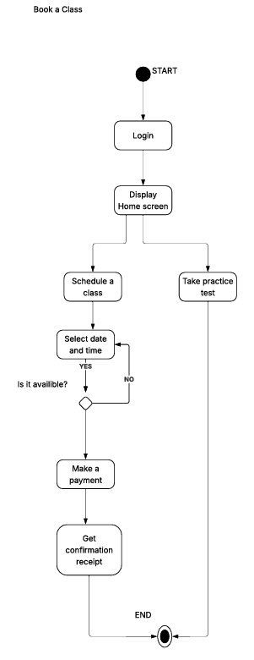
Activity Diagram
Notes:
We will now take a look at how to book a class using this activity diagram. First, students log in and are taken to their home screen. From there, they can choose to schedule a class or take a practice test.
If they choose to schedule a class, they will select a date and time. The system will check if that time is available. If it is, the student can make their payment and receive a confirmation of their booking.
If the time is not available, they will be asked to choose another date and time until one fits within both the student’s and instructor’s availability.

Slide 5
Security
Secure user login and password.
Protected payment information while using system.
The system is kept updated and compliant with DMV policy
Regular system maintenance and continuous monitoring to prevent issues and unauthorized access.
Notes:
Security is an important part of this design. Users will be trusting us to keep their personal and payment information protected.
In this system, users will create a unique username and password to access their accounts. If they forget their password, they can contact IT support for help recovering access.
Payment information will be kept secure, and the system will be regularly maintained to help prevent data leaks. All of this will be done while staying compliant with DMV policies and legal requirements.

Slide 6
System Limitations
System will require internet access.
Class availability will depend on the instructors schedules.
Budget is could limit staff and resources.
System must stay current with DMV policy.
Notes:
There are a few limitations to this system. It will require internet access in order to be used. Class availability will depend heavily on the number of instructors and whether they have open time slots for students.
This also ties into the company’s budget, which can affect hiring instructors, providing training vehicles, and other necessary resources. The system must also stay current with DMV policy, which could change at any time.

Slide 7

Thank You!

